Slide 1
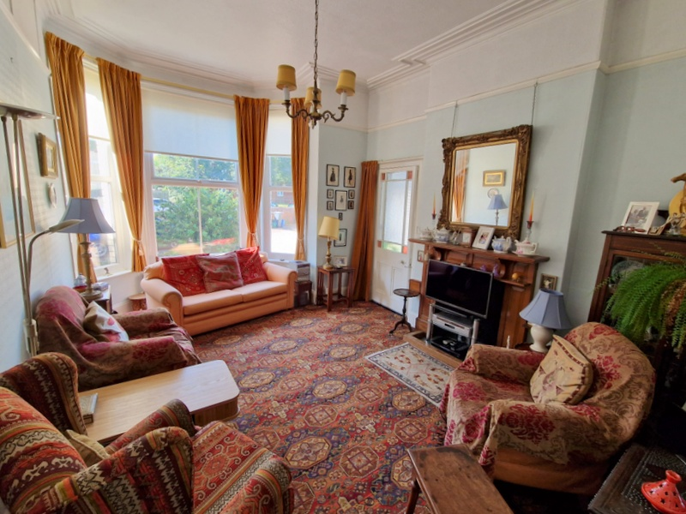
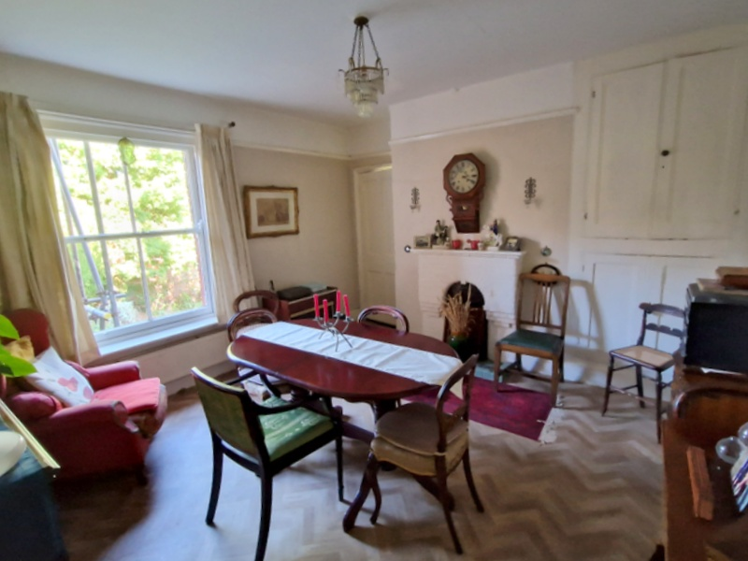

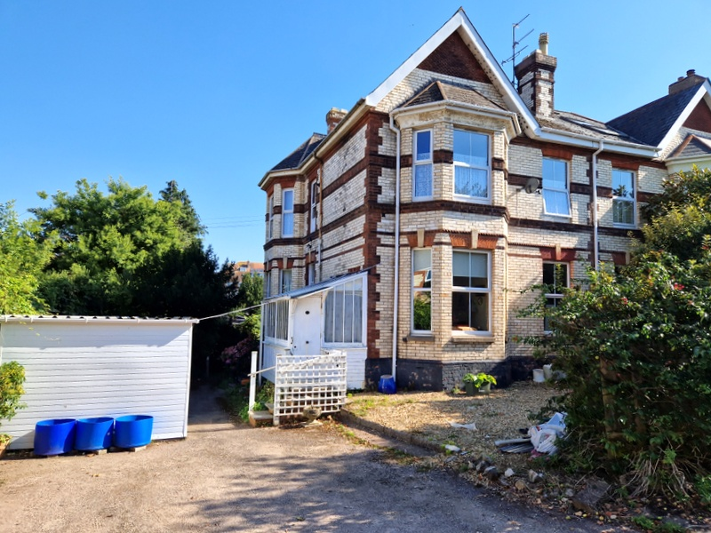
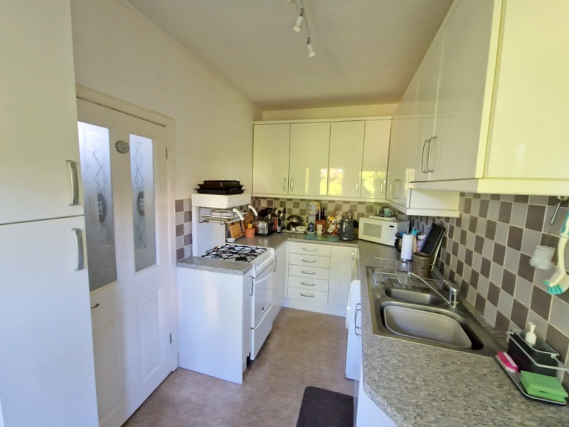
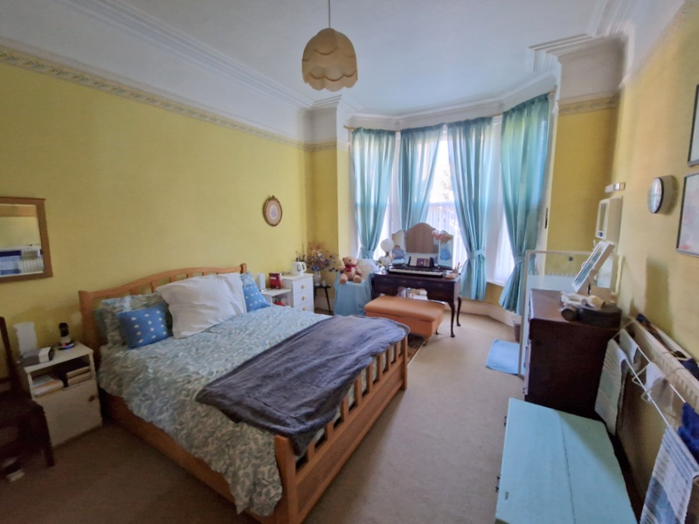
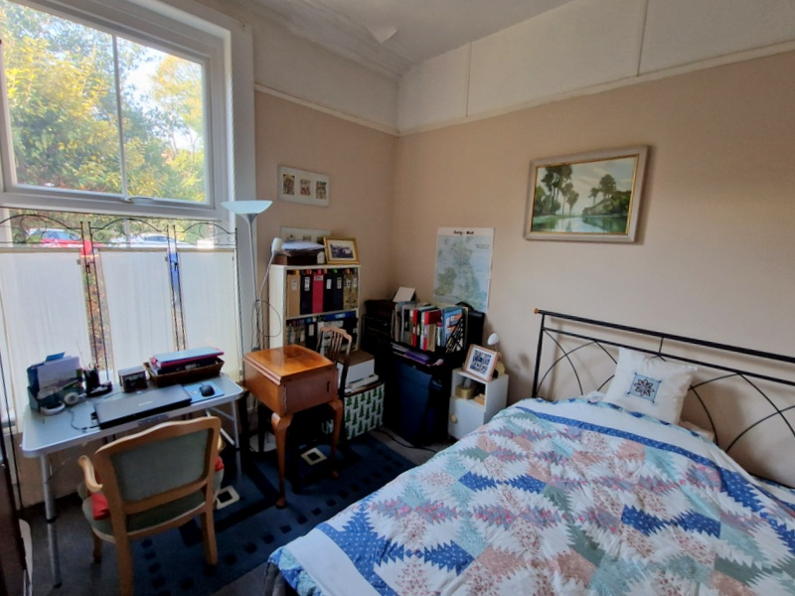
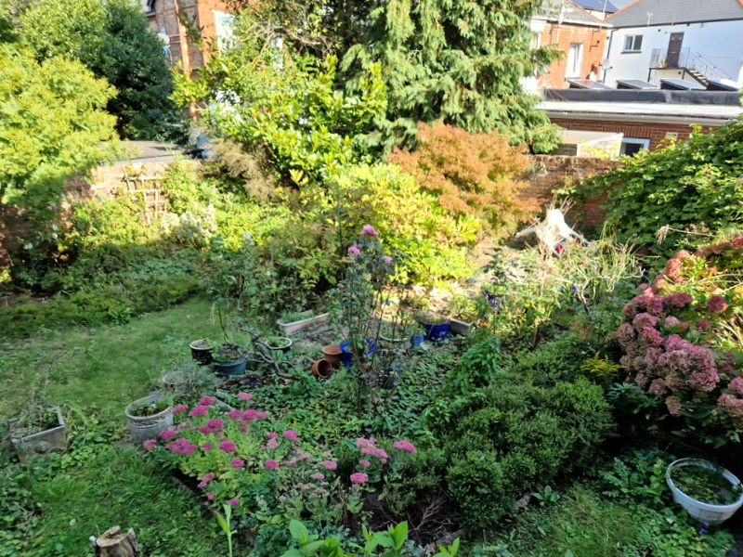
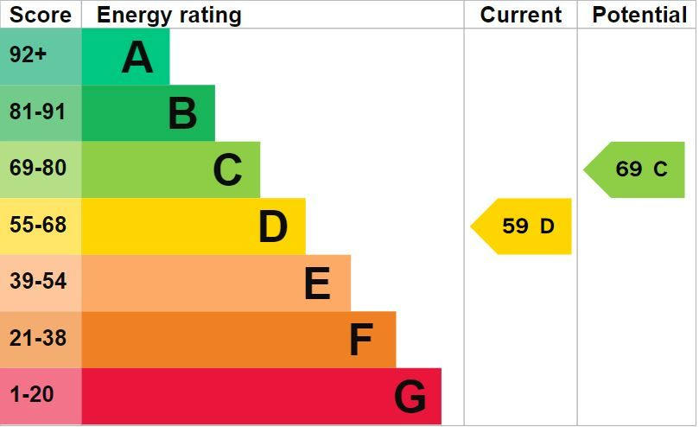

www.pennys.net
Flat 1, 21 Rolle Road, Exmouth, EX8 2AW
GUIDE PRICE £225,000
TENURE Freehold
A Most Spacious Freehold Ground Floor Flat Located Close To The Heart Of Exmouth Town Centre With Its Own Good Size Garden
Own Private Entrances * Elegant Bay Windowed Lounge * Separate Dining Room * Two Double Bedrooms * Shower Room * Cloakroom/Wc * Gas Central Heating * Some Double Glazing * Own Garden
Pennys Estate Agents Limited for themselves and for the vendor of this property whose agents they are give notice that:- (1) These particulars do not constitute any part of an offer or a contract. (2) All statements contained in these particulars are made without responsibility on the part of Pennys Estate Agents Limited. (3) None of the statements contained in these particulars are to be relied upon as a statement or representation of fact. (4) Any intending purchaser must satisfy himself/herself by inspection or otherwise as to the correctness of each of the statements contained in these particulars. (5) The vendor does not make or give and neither do Pennys Estate Agents Limited nor any person in their employment has any authority to make or give any representation or warranty whatever in relation to this property.
PENNYS ESTATE AGENTS
2 Rolle House, Rolle Street, Exmouth, Devon, EX8 2SN
Tel: 01395 264111 EMail: help@pennys.net

Slide 2
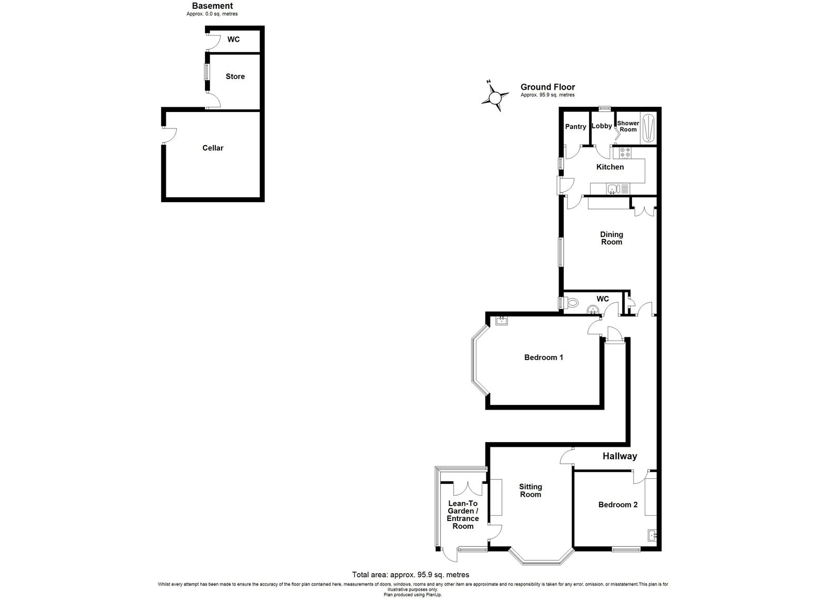
Flat 1, 21 Rolle Road, Exmouth, EX8 2AW
THE ACCOMMODATION COMPRISES: The apartment can be accessed via two private entrances. To the rear of the property there is an entrance canopy with part glazed door giving access to:
KITCHEN: 3.91m x 2.08m (12'10" x 6'10") Fitted with patterned worktops with inset one and a half bowl single drainer sink unit with mixer tap, with cupboards, drawer units and plumbing for automatic washing machine beneath, tiled surrounds, wall mounted cupboards, gas cooker point, radiator, window overlooking the gardens, good size shelved larder cupboard and door to:
DINING ROOM: 3.96m x 3.89m (13'0" x 12'9") plus doorway recess. With feature brick fireplace with hearth, built-in floor to ceiling shelved storage cupboards in wall recess, sash window, radiator, picture rail, further fitted shelved shallow cupboard, door to:
INNER HALLWAY: With radiator, access to understairs storage cupboard, telephone point.
SITTING ROOM: 5.31m x 3.61m (17'5" x 11'10") A spacious elegant room with measurement into uPVC double glazed bay window overlooking the front aspect, attractive wooden fire surround with tiled hearth, picture rail, cornice ceiling, radiator, part glazed door to:
LEAN-TO GARDEN/ENTRANCE ROOM: 2.44m x 2.01m (8'0" x 6'7") With door giving access to front aspect, window and fitted cupboards, radiator.
BEDROOM ONE: 5.74m x 3.78m (18'10" x 12'5") A most spacious room with measurement into bay window fitted with three sash windows, radiator, vanity wash hand basin with light/shaver socket over, picture rail, cornice ceiling.
BEDROOM TWO: 3.51m x 3.25m (11'6" x 10'8") With pedestal wash hand basin with tiled splashback, light/shaver socket over, uPVC double glazed window to front aspect, picture rail, cornice ceiling, radiator.
CLOAKROOM/WC: Fitted with wash hand basin, WC, part tiled walls, window with frosted glass.
From the kitchen there is a part glazed door to:
LOBBY AREA: With shelving, tiled walls, recessed ceiling, led spotlighting, window and door to:
SHOWER ROOM: Fitted with good size shower cubicle with sliding shower splash screen door, shower unit, chrome heated towel rail, recessed ceiling spotlighting, tiled walls.
OUTSIDE: The property enjoys a good size garden which is laid to lawn, which comprises lawned area with well stocked and mature flower and shrub beds, decorative stone, seating area and access to CELLAR, brick garden store (boiler for hot water and central heating located here) and OUTSIDE WC.
AGENTS NOTE: 21 Rolle Road consists of three freehold flats with an informal shared maintenance agreement between the flats, due to this arrangement arranging mortgage finance will be difficult therefore we would advise speaking to our Mortgage Advisor before proceeding to view.
Mortgage Assistance: We are pleased to recommend Meredith Morgan Taylor, who would be pleased to help no matter which estate agent you finally buy through. For a free initial chat please contact us on to arrange an appointment. Your home may be repossessed if you do not keep up repayments on your mortgage. Meredith Morgan Taylor Ltd is an appointed representative of The Openwork Partnership, a trading style of Openwork Ltd which is authorised and regulated by the Financial Conduct Authority (FCA).
FLOOR PLAN:

